Slide 1
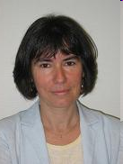
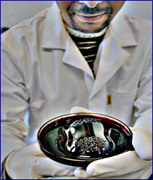
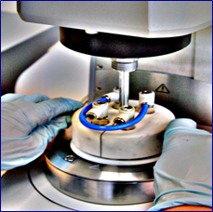
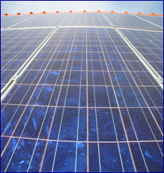
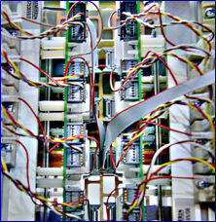
4 Complementary teams
Present Head: Pr. Betty Semail
L2EP Lab.
Prof. and Associate. Prof. (36)
PhD Students (42)
OMN
(Optimization and Numerical Modelling)
Control
Power
systems
Power
Electronics
Tactile Devices
eV energy management
- Design of Multiphase drives
Electrical Grid
HVDC
Stability analysis
MMC
-Design of
High Frequency PE components
-Topology
Numerical Modeling
of Electromagnetic systems (machines, cables, transformers…)

Slide 2

« electricity & Vehicles » Platform
…………….
CONTROL team
L2EP – Université de Lille
2022
electricity
& Vehicles

Slide 3
Outline
1
Objective & Means
2
Vehicle Activities
3
Infrastructure Activities
Example: Traction Power Supply for Railway Line

Slide 4
1
Objective & Means
2
Vehicle Activities
3
Infrastructure Activities
Example: Traction Power Supply for Railway Line

Slide 5
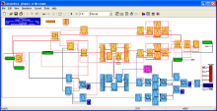
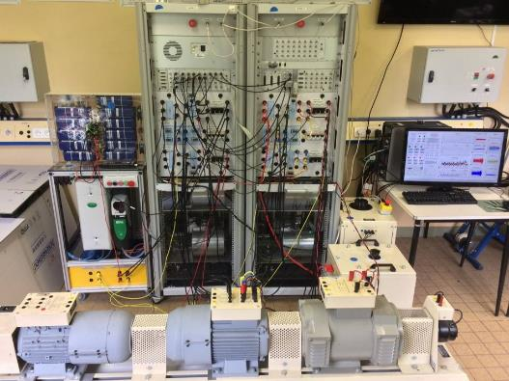
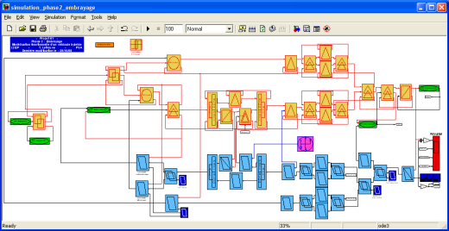

Objective of the “eV” platform
validation of new vehicle concepts (from subsystems to vehicles)
for more efficient and less pollutant transportation systems
Formalisms
of Control
team
New concepts (e.g. hybrid storage)
New methods
(e.g. HIL testing)
New control (e.g. optimal EMS)
Example of validation
Emulation
Interface
Real-time
simulation
of the vehicle
Subsystems under test
Generalized
Vectorial
Formalism
Energetic
Macroscopic
Representation
Notes:
Une partie système véhicule : on a nécessairement besoin de HIL temps réel
Une partie drive : on travaille plus sur les drives, la partie HIL est moins dispensable
Dans une partie plus véhicule on doit se diriger vers du HIL

Slide 6








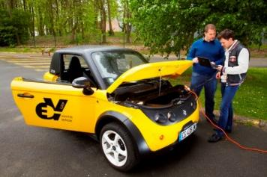

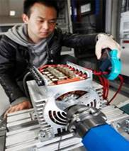


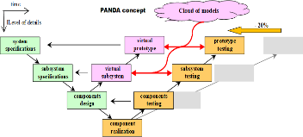
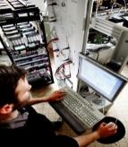
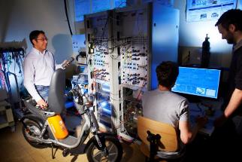
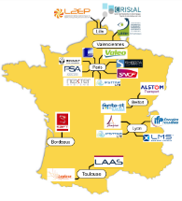
Involvement in key projects
Local: CUMIN
(carbon neutral campus
via e-mobility)
Regional: CE2I / ELSAT
Vehicle usages
for Living Lab
Campus
Testing new
concepts of
e-drives
(cloud) HIL
testing of
EV / HEV / FCV
Platform
Validation
of new energy
management strategies
International: H2020 PANDA
National: MEGEVH
Notes:
Une partie système véhicule : on a nécessairement besoin de HIL temps réel
Une partie drive : on travaille plus sur les drives, la partie HIL est moins dispensable
Dans une partie plus véhicule on doit se diriger vers du HIL

Slide 7



















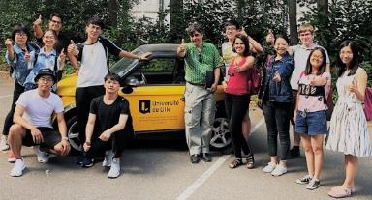








Collaborations & education
Industry
Region: C2EI / ELSAT
University: CUMIN
National Labs
Platform
Education
Master ULille / A&M ParisTech, etc.
International
summer
schools:
EMR
ACES
HIL
International Labs
eCAMPUS
International Lab
(France / Canada)
Demo & driving
Notes:
Une partie système véhicule : on a nécessairement besoin de HIL temps réel
Une partie drive : on travaille plus sur les drives, la partie HIL est moins dispensable
Dans une partie plus véhicule on doit se diriger vers du HIL

Slide 8
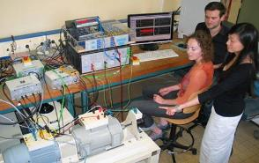
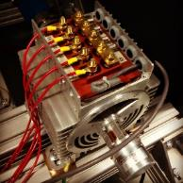
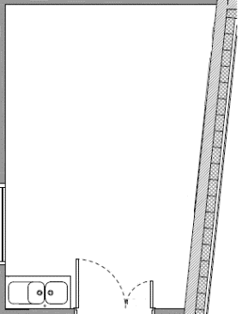
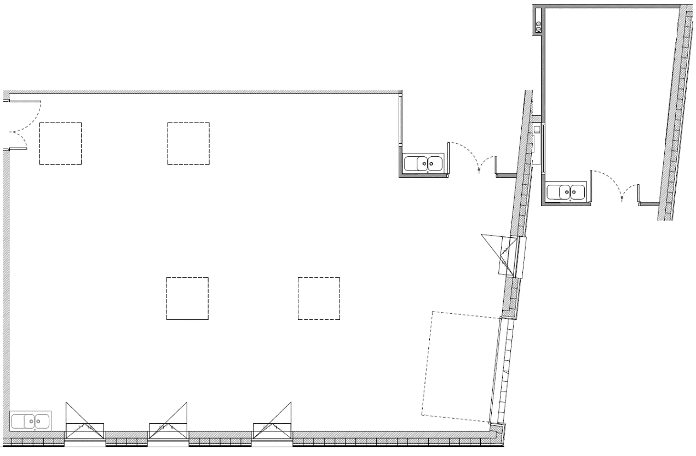
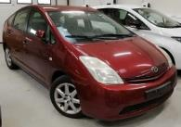
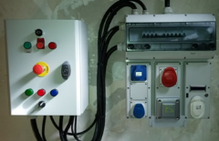
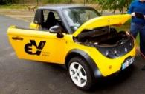
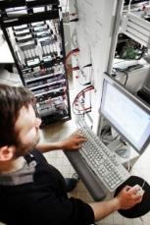
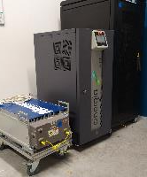
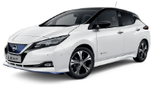
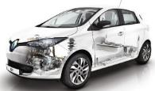
e-X Workspaces
10 classical electrical machines from 2 to 20 kW
e-infrastructure
workspace
7 multiphase machines
(5-, 6- and 7-phase)
for low and high voltages (from 48V to 230V)
from 3 to 15 kW
e-drive
workspace
traction power
supply for railway line
Platform
e-transmission
workspace
planetary geartrain
for hybrid vehicle
charging
stations
Fuel Cell
e-vehicle
workspace
Ni-MH Bat
Li-ion Bat
e-storage
workspace
4 Scap banks
Notes:
8
Ulille : système véhicule
A&MPT : système drive
Migration : insérer les systèmes drive polyphasés dans les véhicules
Les systèmes polyphasés sont utiisés principalement pour les véhicules aujourd’hui
Serveur donnée
Les drives peuvent être utilisés dans des systèmes plus globaux, en simulant des pannes véhicule ou comment il s’insére dans la gestion véhicule. Migration totale
Plus de 60 V

Slide 9
1
Objective & Means
2
Vehicle Activities
3
Infrastructure Activities
Example: Traction Power Supply for Railway Line

Slide 10
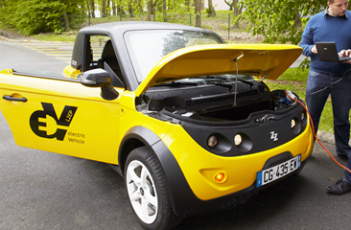
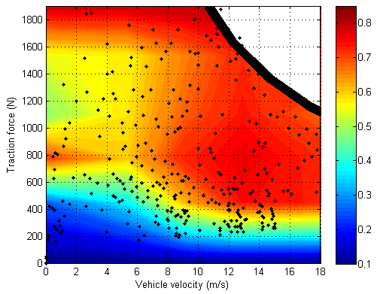
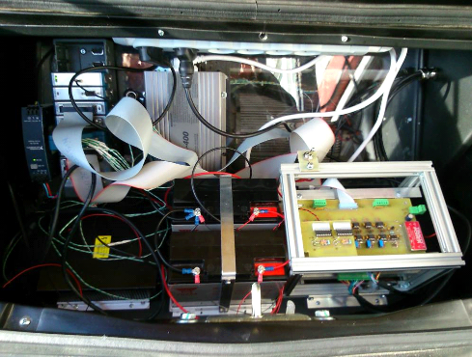
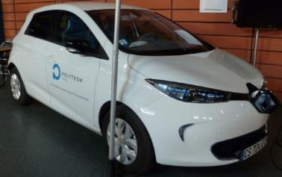
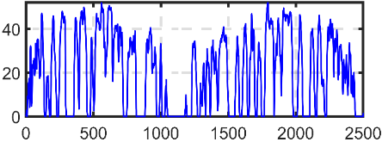

Validation of e-subsystems from real e-vehicle
Tazzari Zero
real extra-urban driving cycle
model used in
efficiency map
error on consumption: 4.7%
Electric Traction drive
on-board acquisition system
|PhD Dépature 17]
Model validation
real urban driving cycle
for different driving
& climatic conditions
Renault Zoé
error on consumption: 2%
Heating, ventilation, and Air Conditioning (HVAC)
|PhD Desresveaux 20]
simulation model
based on EMR
model used in
CUMIN

Slide 11
1
Objective & Means
1
2
Vehicle Activities
3
Infrastructure Activities
Example: Traction Power Supply for Railway Line

Slide 12
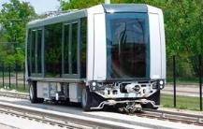

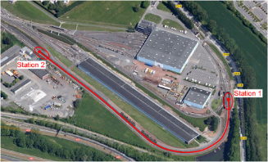
Traction Power Supply for Railway Line
Développement simulateur
carrousel de métros (via la REM)
Validation modèle
sur la plateforme
Validation modèle
avec métro réel
Validation simulateur
sur piste d’essai
en mono-train
Validation simulateur
en multi-train ??
HIL sur plate-forme eV
[PhD Mayet 16]

Slide 13

Traction Power Supply for Railway Line
Plate-forme expérimentale
Contrôle (carte dSPACE 1103)

Slide 14




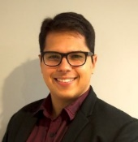
Traction Power Supply for Railway Line
Next Step
CUMIN
REMUS (Recovery of Energy of Metros for Universities with Sustainability)
TPS 1
TPS 2
TPS 3
Subway 1
Subway 2
Subway 3
Subway 4
Subway 5
Subway 6
CS 1
CS 2
Management ECU
Management ECU
Management ECU
Management ECU
Actual set-up
Extension to 3 TPS, 6 subways
2 charging stations for EVs
|PhD O’Berriel]

Slide 15
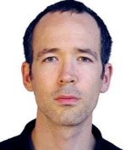
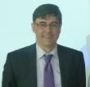
1
Objective & Means
Walter LHOMME
Alain BOUSCAYROL
2
Drive Activities
Example: Open-Phase Fault Detection
3
Vehicle Activities
4
Infrastructure Activities
Example: Traction Power Supply for Railway Line

Slide 16
Outline
1
Objective & Means
2
Drive Activities
Example: Open-Phase Fault Detection
3
Vehicle Activities
4
Infrastructure Activities
Example: Traction Power Supply for Railway Line

Slide 17
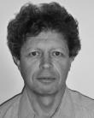
1
Objective & Means
2
Drive Activities
Example: Open-Phase Fault Detection
Éric SEMAIL
3
Vehicle Activities
4
Infrastructure Activities
Example: Traction Power Supply for Railway Line

Slide 18
Détection défaut onduleur 5 phases…projet CE2I
TRANSITION ENERGETIQUE ? → TRANSPORT EFFICIENT ENERGETIQUEMENT
ELECTRIFICATION VEHICULE ? INTERET ENERGETIQUE PROUVE ? OUI
REALITE : COUT ELEVE ELECTRIFICATION → TROP PEU DE VEHICULES CONCERNES
DEFI HYBRIDATION = réduire coût : Structure/Onduleur/Machine…?
MACHINE à PLUS de 3 PHASES et ELECTRIFICATION VEHICULE ?
3 PHASES = Défaut Onduleur… FATAL → DIMENSIONNEMENT SILICIUM
€€€€ pour MTBF désiré
(Mean Time Between Failures)
5 PHASES et + = Défaut Onduleur… TOLERE → « SOUS »-DIMENSIONNEMENT
€€ pour même MTBF fonctionnel

Slide 19
5-phase Drive Fault Detection: project CE2I
Multi-phase Machine Decomposition using VGF
[Semail 2003]
5-phase PMSM
Equivalent to TWO 2-phase machines
MM
SM
Real 5-phase machine
TORQUE
Main
machine
Second.
machine
h = 1, 9, 11,…,h=5k ± 1
h = 3, 7, … h=5k ± 2
DC bus
5-leg VSI
T
shaft
load
v
m
i
m
mm
V
v
MM
T
Ω
DC
vsi
i
e
Ω
tot
m
m
i
v
s
i
s
T
sm
Ω
T
DC
i
mach
SM
load
m
i
s
e
s
Ω
vsi
v_{m-ref}
T_{mm-ref}
T
v_{vsi-ref}
Tot-ref
Ω
i_{m-ref}
ref
v_{s-ref}
T_{sm-ref}
i_{s-ref}
Strategy

Slide 20
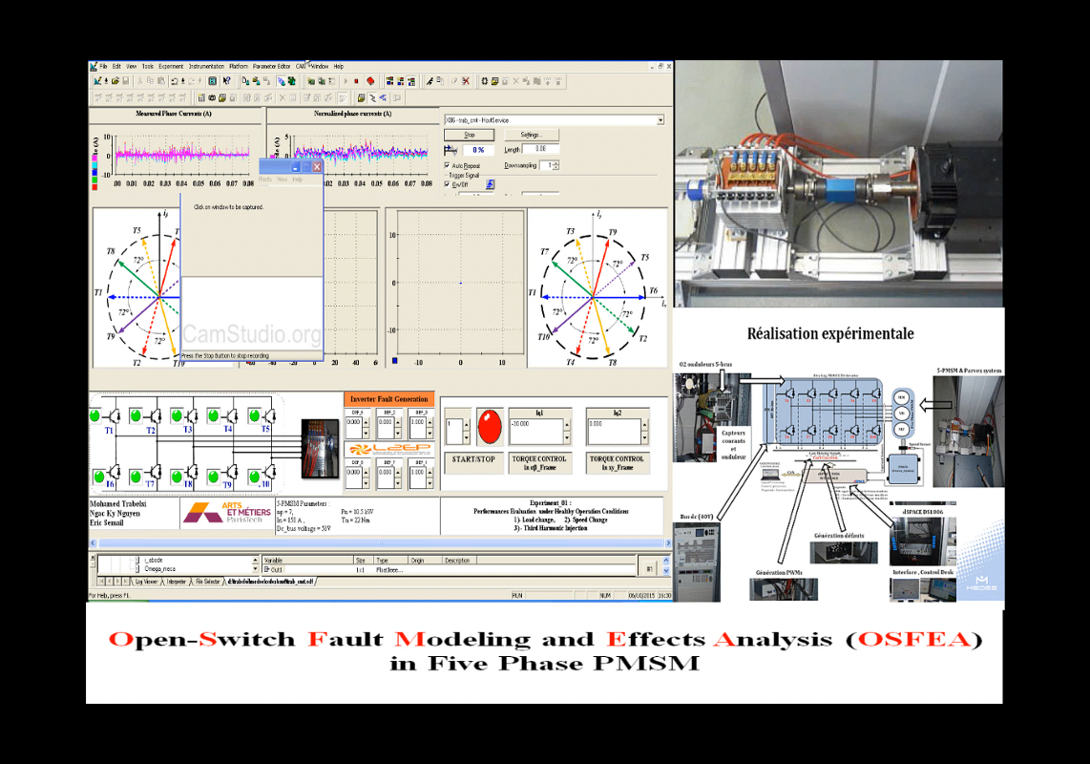
Open-Switch and Open-Phase Fault Detection
Measured Currents
Normalized Currents
5-Phase Machine
MM
SM
Fault Creation

Slide 21

1
Objective & Means
1
2
Drive Activities
Example: Open-Phase Fault Detection
3
Vehicle Activities
Florian TOURNEZ
Ingénieur d’Etudes de la PF eV
4
Infrastructure Activities
Example: Traction Power Supply for Railway Line

Slide 22
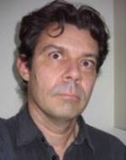
1
Objective & Means
1
2
Drive Activities
Example: Open-Phase Fault Detection
3
Vehicle Activities
4
Infrastructure Activities
Example: Traction Power Supply for Railway Line
Philippe DELARUE

Slide 23

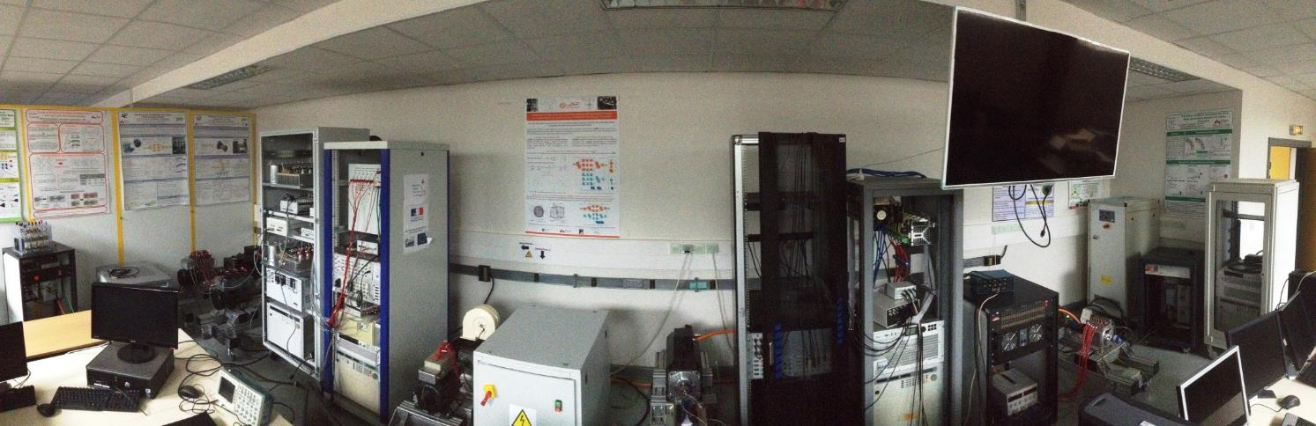
1 – eV platform: drive activities
site
electricity
& Vehicles
Dual 6-phase PM drive
(THALES ALENIA SPACE)
5-phase 48V PM drive for mild-hybrid automotive (VALEO)
5-phase bi-harmonic PM drive
5-phase trapezoidal PM drive
Two 7-phase PM generators, Two 5-phase PMSM drives, Two 6-phase PMSM drives
Power Supplies and Electronic Loads: 5 to 15 kW / 12V, 48V to 500 V
5 Industrial 3-phase drives for mechanical load emulation (Parvex Drives)
Rapid prototyping control: Dspace 1005, 1006, MicroLabox, Opal–RT

Slide 24


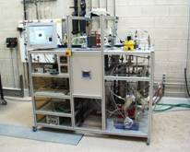

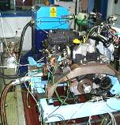

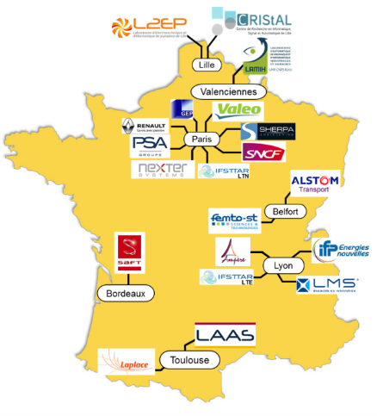
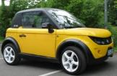

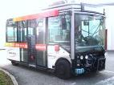
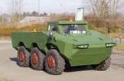
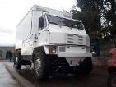
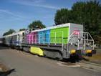


1 – eV platform: MEGEVH
http://www.megevh.org
MEGEVH-macro
6 projects in progress
4 PhDs in progressed
8 PhDs defended
8 industrial partners
10 laboratories
MEGEVH-strategy
MEGEVH-optimization
MEGEVH-FC
MEGEVH-storage
Experimental Platforms
Reference Vehicles
Notes:
24

Slide 25
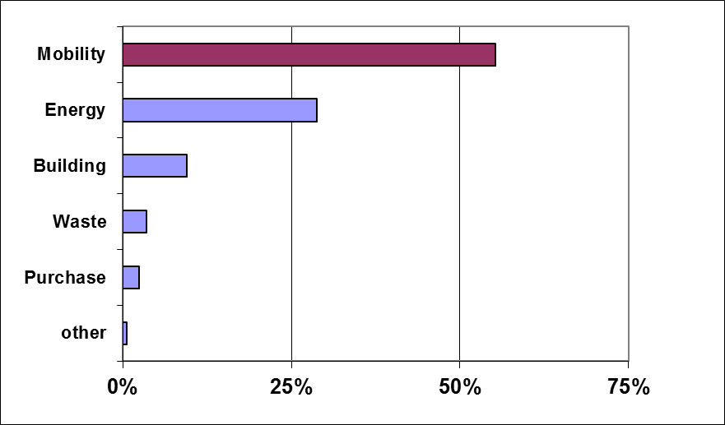



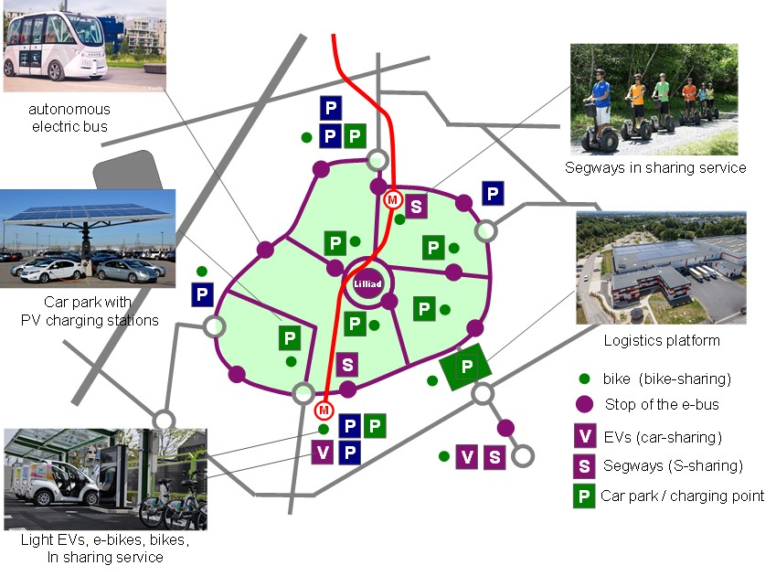
1 – eV platform: CUMIN
25
Campus Universitaire à Mobilité Innovante et Neutre en carbone
56%
Bilan Carbone Campus
Cité Scientifique 2015
en cours
Étude potentiel ENR
Etude consommation VE
Etude infrastructures de charge
Etude trajets journaliers
en projet
Etude acceptabilité
Etude modèle économique

Slide 26











1 – eV platform: PANDA
Coordination RIA H2020
Powerful Advanced N-level Digital Architecture for models of EVs and components
Grant Agreement 824256 - 3,5 M € - 3 years – 11 partners – 6 countries
GA 824256
Organisation unifiée de modèles de véhicules électrifiés et de leurs composants
pour le prototypage virtuel et le test réel (REM au cœur de la démarche)

Slide 27

Validation of the vehicle model including HVAC
Real urban driving cycle
« cité Scientifique » - Lille, 14 km , 40 min, 30°C
Velocity (km/h)
Renault Zoe
+ instrumentation
for different driving
& climatic conditions
time (s)
Validation of the simulation model
Error on energy consumption 2%
simulation model based on EMR
model used in
|PhD Desresveaux 20]

Slide 28

Interest of the validated model
Fair Energy consumption during a year
(without traffic and driver impact)
Range reduced by
30% in winter
simulation model based on EMR
CUMIN
|PhD Desresveaux 20]
results for
supported by
eCAMPUS
International Lab
(France / Canada)
Nissan Leaf
New cabin model
New vehicle tests
extension to
|PhD Ramsey]

